Slide 1





Slide 2


Slide 3
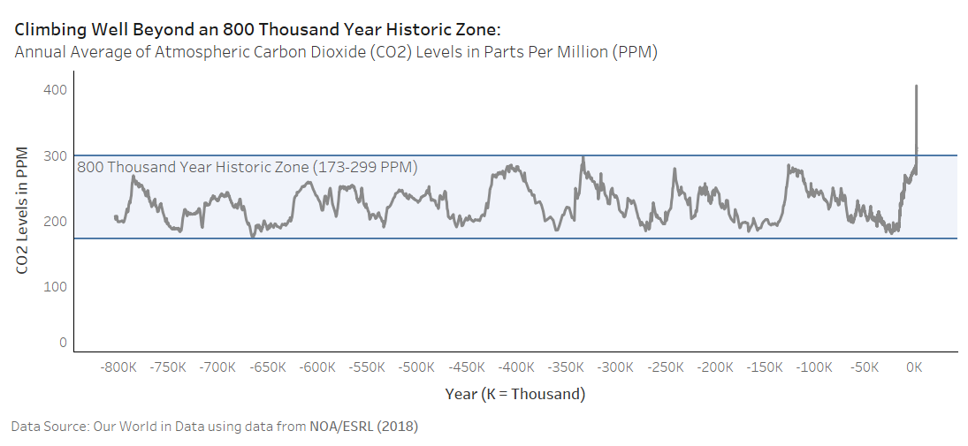

1905

Slide 4
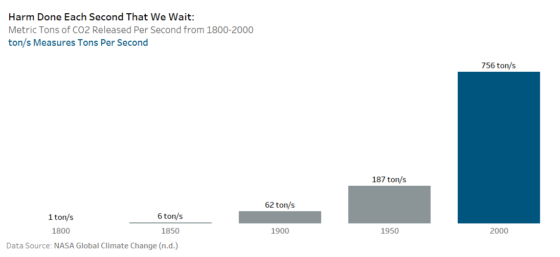

Slide 5
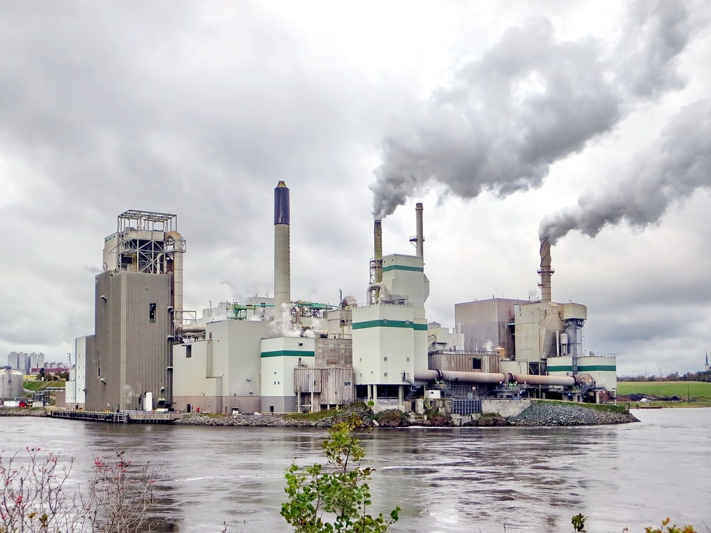
Burning Fossil Fuels

Slide 6
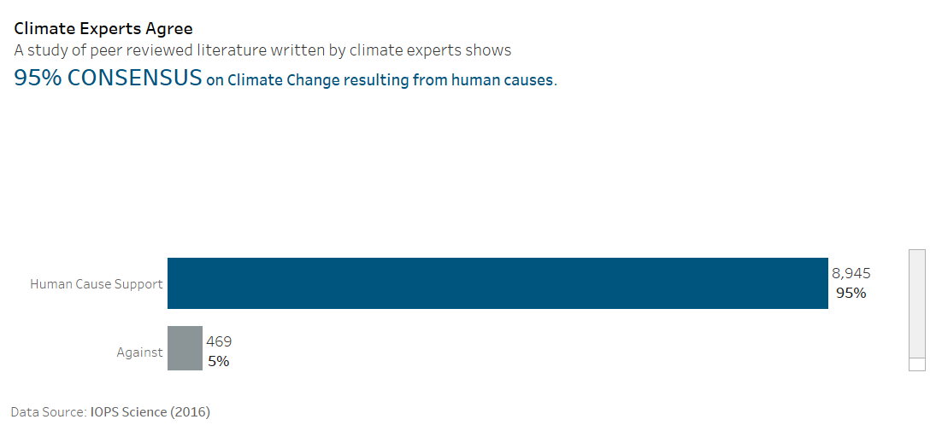


Slide 7
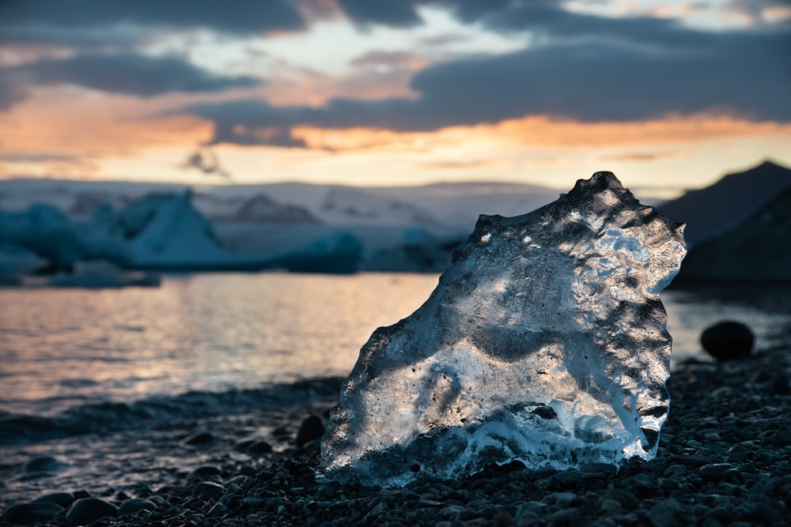
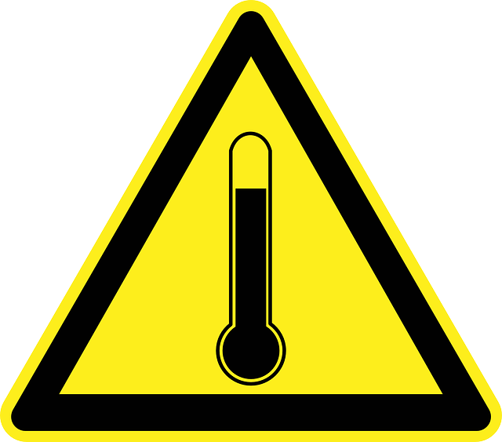
Sea Levels Rise as Oceans Heat Up

Slide 8
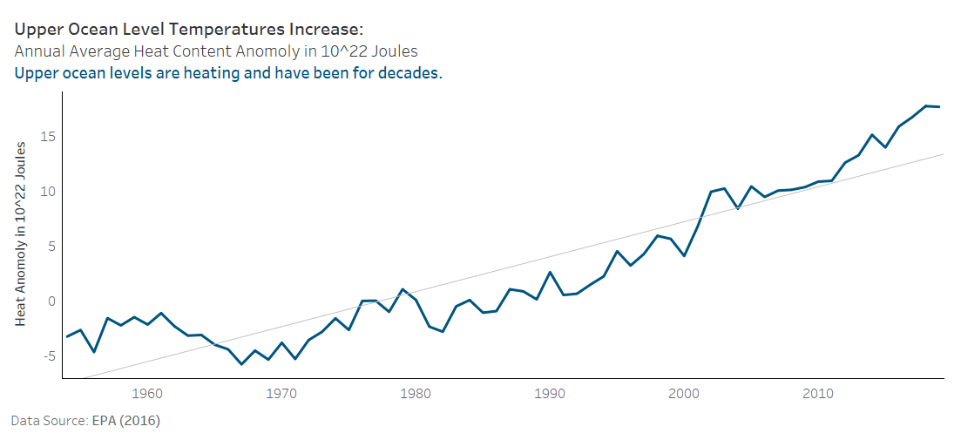

Slide 9
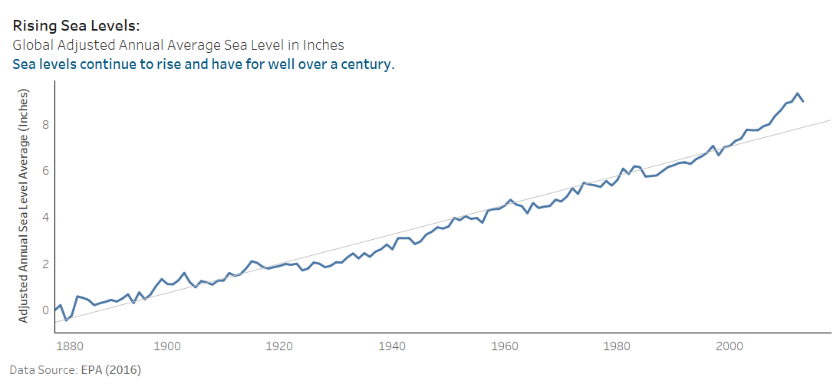

Slide 10
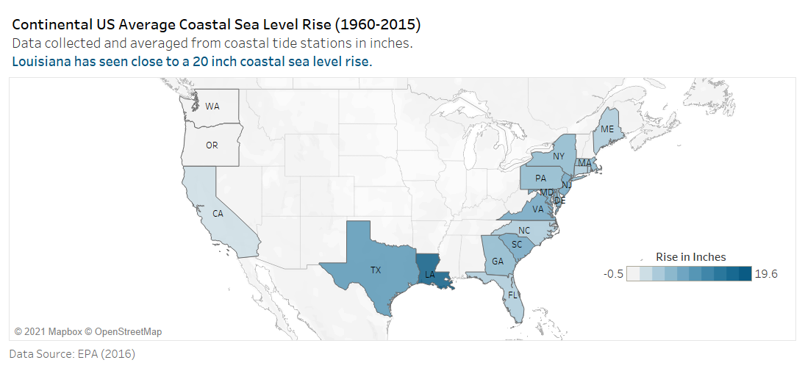

Slide 11
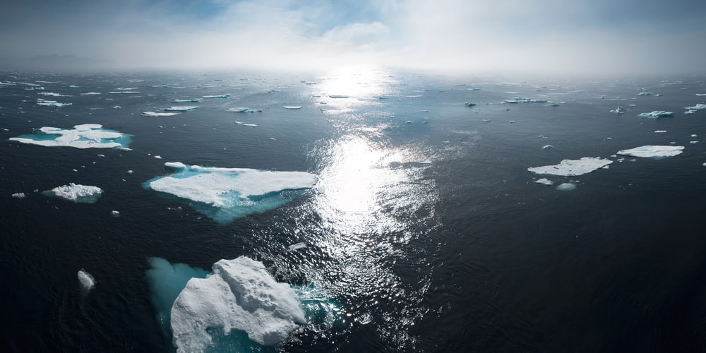

Arctic Ice Melts

Slide 12
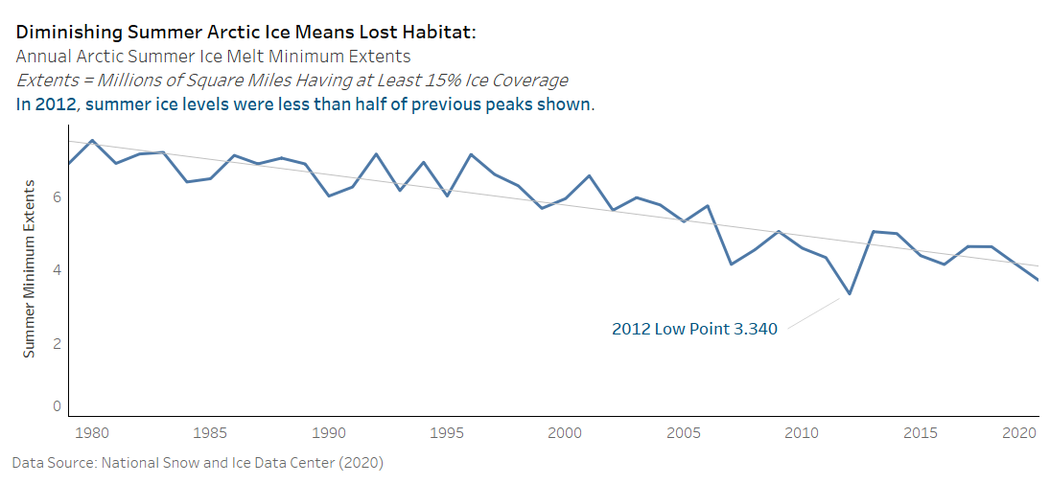
2012
< 50%

Slide 13
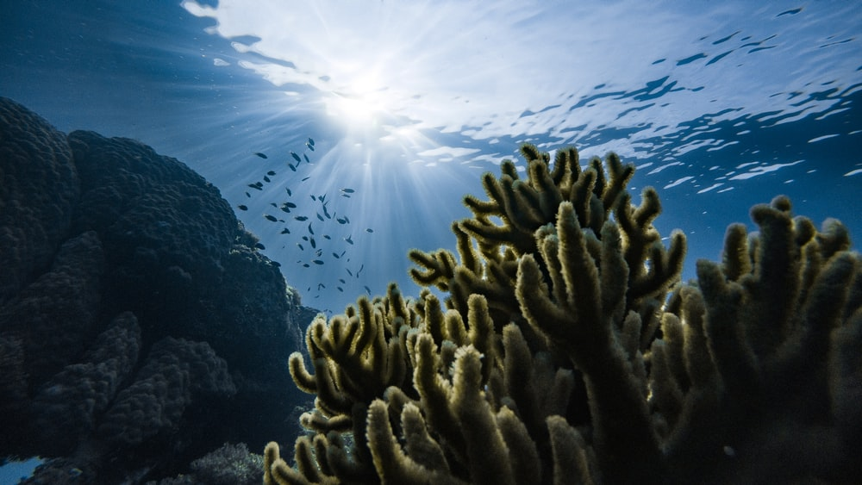

Lower PH Damages Coral Reefs
Oceans 12.7% MORE ACIDIC in 2018 versus 1985

Slide 14

Purchase Fuel Efficient Vehicles
Learn About Your Carbon Footprint
Contact Your Government Officials
Demand Action

Slide 15
Thank you for your attention!
As promised, I kept it short.
By
Sam Loyd

